Slide 1
Layered architecture

Slide 2
Objectives
Knowing why a large application needs layers
Structure a large application into 4 layers
Domain layer
(Application) Logic layer
Infrastructure (or Data) layer
Presentation layer

Slide 3
Why?
Layered architecture

Slide 4
Seperation of concerns
Separate code into different components / layers
Each component / layer takes on a piece of functionality
As few as possible overlaps (loose coupling)
Complexity gets encapsulated behind a well-defined interface to the rest of the code
Code is more readable
Easier to add new features
Easier to maintain the code
Notes:
Complex applications need some “Separation of concerns” that groups the code into components and on a higher level into layers.
Each component / layer takes on a specific part of the functionality with as few overlaps between the components / layers as possible.
In other words: the components / layers should be loosely coupled.
Thanks to “Separation of concerns” a lot of the complexity gets encapsulated while having a well-defined interface to the rest of the code.
This makes the code more readable, easier to extend with new features and easier to maintain.

Slide 5
Layers
High-level grouping of components
Each layer contains components that specialize in a certain aspect of the application
E.g. the “Presentation layer” contains components that are responsible for the user interface (UI)
E.g. the “Infrastructure layer” takes care of communication with infrastructure (e.g. a database)
Layers have a public interface for other layers to use, while encapsulating the inner workings of the layer
Notes:
Separation of concerns can be applied at multiple levels in the code.
At a lower level the code is grouped into classes. Each class encapsulates complexity while having a public interface (the public properties and methods) that other classes can use.
On a higher level the code can be grouped into layers.
Each layer contains components (classes) that specialize in a certain aspect of the application.
The “Presentation layer”, for example, contains the components that are responsible for the user interface (UI) of the application.
The “Infrastructure layer”, for example, contains the components that are responsible for communicating with infrastructure (e.g. a database).
A layer has a public interface that other layers can use (except the top layer), while encapsulating the inner workings of the layer.

Slide 6
How?
Layered architecture

Slide 7
Project per layer
Solution can contain multiple projects
Each layer in its own project
Helps to enforce separation of concerns
Helps to encapsulate the inner workings of a layer
Notes:
By using a different project for each layer the components (e.g. class) are physically separated and it will be more difficult to mistakenly use a component of another layer that should not be used.
Also different projects result in different assemblies (dll’s). This enables you to hide certain components (classes) from other layers by using the internal keyword…

Slide 8
internal
Access modifier (like public, private, protected)
An internal class is only visible for classes in the same project (assembly)
Prefer internal over public classes
Simplifies the public interface for other layers

Slide 9
Domain layer
Models the state and behavior of the business domain
Class for each entity in the domain
State is modeled with properties
Behavior is modeled with methods
Is the core of the application
Does not depend on other layers

Slide 10
Example application
An IT company wants to be able to generate pair programming pairs for the developers of a team
Pair programming: wiki
Multiple teams, not all team members are developers
HR employee must be able to randomly generate developer pairs once per week

Slide 11
Domain layer - example
After talking with some people at the company, the following business domain entities can be detected:
Employee
State: employee number, first name, last name and a type
EmployeeType
State: developer, account manager or other
Team
State: id, name and multiple employees
ProgrammingPair
State: driver, navigator
Notes:
At the moment we cannot detect any behavior (methods) in the domain, but if we do we can add the behavior later on.

Slide 12
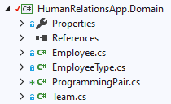
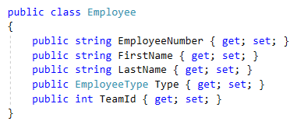
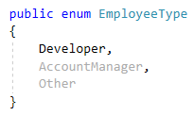
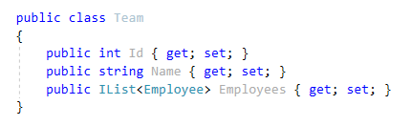
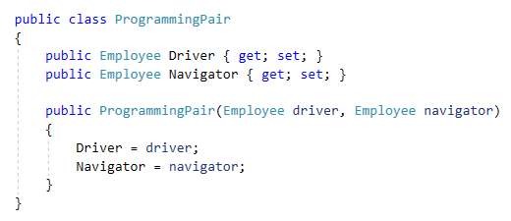
Domain layer - example
Notes:
Note that all classes (entities) are public. Other layers will need access to these entities.

Slide 13
(Application) Logic layer
Models the use cases of the application
Service classes use the domain layer classes to complete use cases
Public interface (for outer layers), internal concrete implementation
Service classes may need to communicate with a database
Data access (repository) interfaces are defined here, but not implemented. The concrete implementation is the responsibility of the infrastructure layer
Only communicates with the domain layer, no other layers
In the past this layer was sometimes called “Business layer”

Slide 14


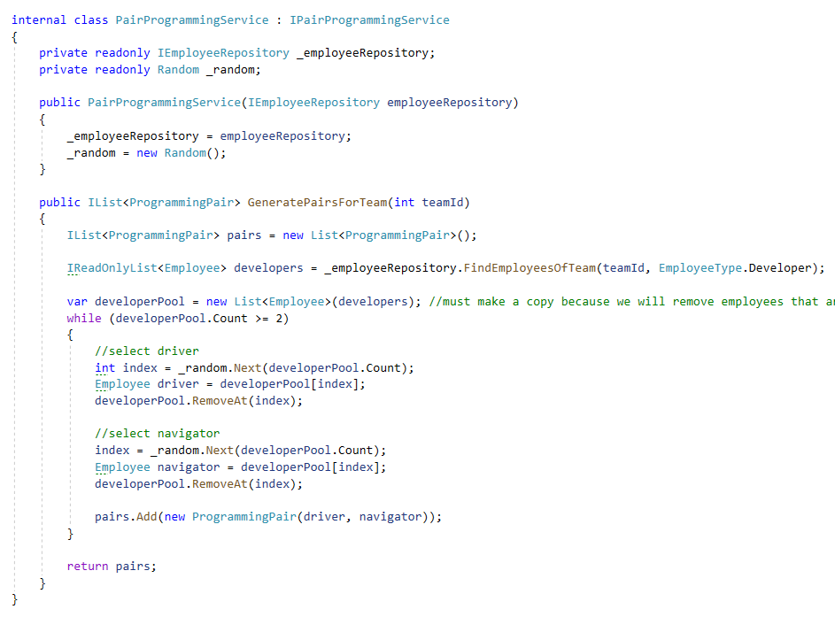
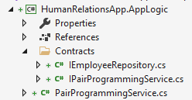
Logic layer - example
Notes:
What do we need for the use case “As an HR employee I want to be able to generate a list of programming pairs for a team”?
We’ll define an interface IPairProgrammingService that does just that.
We make the interface public so it can be used by the presentation layer.
The (application) logic layer should also define an implementation of the service.
We make this class internal to force outer layers to use the interface instead of the concrete implementation.
To implement the GeneratePairsForTeam method we need some way to retrieve all the developers of a team from data storage.
In the logic layer we don’t add concrete classes that do data access, that’s the responsibility of the infrastructure layer (data layer).
How can we do data access without referring to the infrastructure layer (the logic layer can only refer to the domain layer)?
What we can do is to define an interface that contains methods for data access in the logic layer.
And instead of using a concrete class to access data, we use that interface in our service class.
The interface will be implemented in a concrete class in de infrastructure layer later on.
In the logic layer we don’t need to know how the data is stored (database, file, in-memory), an interface that describes how the data can be retrieved is sufficient.
For the data access we define an IEmployeeRepository interface. This repository will be responsible for retrieving employees from storage.
The interface contains a method FindEmployeesOfTeam that returns an IReadOnlyList<Employee>.
(When returning multiple items, it is often a good idea to return an IReadOnlyList<T>. This way client code (of other classes) cannot add or remove items from the returned list.)
To allow our service to use the IEmployeeRepository we add it as a parameter in the constructor and assign it to a private (readonly) field.
Now the service can use this repository without knowing how the employees are actually retrieved.
The GeneratePairsForTeam method uses the repository to retrieve all developers of the team.
Then it executes a while-loop that randomly selects a driver and a navigator in each iteration.

Slide 15
Infrastructure layer
Links with a concrete storage medium (e.g. database)
Implements the data access interfaces (repositories) defined in the logic layer
Also communicates with other infrastructure like a mail service, file system, … (out of scope for this course)
References the logic layer and domain layer (no other layers)

Slide 16
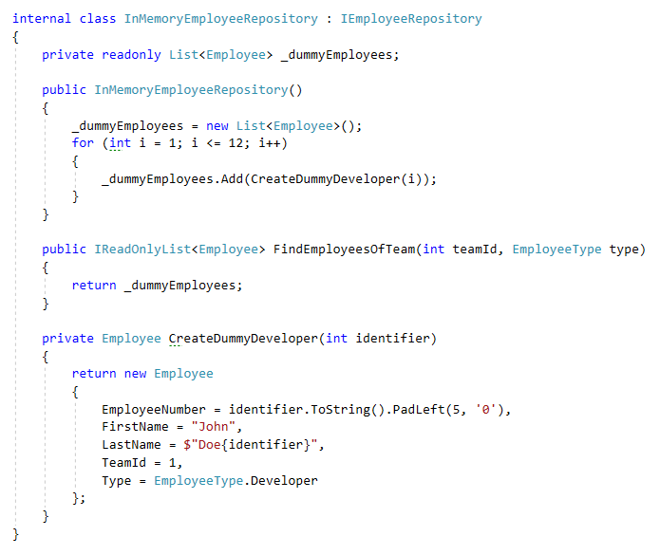

Infrastructure layer - example
Notes:
In the infrastructure layer we provide a concrete implementation of the IEmployeeRepository interface.
Since we don’t know (yet) how to interact with a database, we’ll do a dummy (in-memory) implementation for now.
In the constructor we initialize a list of 12 dummy developers that is returned when the FindEmployeesOfTeam method is executed.
We will provide a better implementation later on when we know how to work with Entity Framework (a .NET database access framework).
The nice thing is that we can use another implementation of IEmployeeRepository without having to change 1 line of code in the application logic layer.

Slide 17
Presentation layer
Contains components that are responsible for showing information to the end users and to interpret commands of these end users
Uses the public interface of the logic layer and domain layer

Slide 18
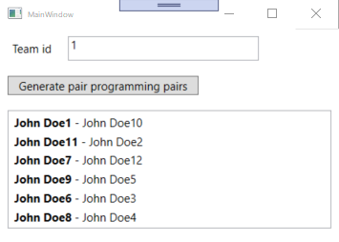
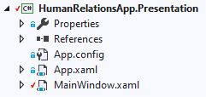
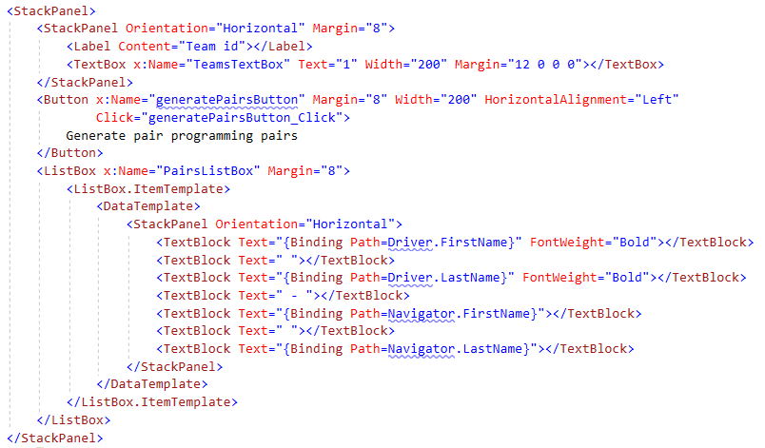
Presentation layer - example

Slide 19
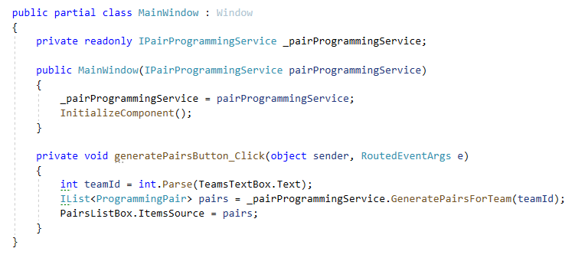
Presentation layer - example
Notes:
To allow our window to use the IPairProgrammingService we add it as a parameter in the constructor and assign it to a private (readonly) field.
Now the window can use this service without knowing how the programming pairs are generated.
The presentation layer does not need to know if or how the developers are retrieved from storage and what algorithm is used to mix the developers in pairs.
It just needs to know that it can call the GeneratePairsForTeam method of the service that was injected in the constructor.

Slide 20
Wiring
Internal services (logic layer) and repositories (infrastructure layer) need to be instantiated somewhere
Presentation layer = executing program => needs to wire everything together
Forces us to reference infrastructure layer and expose internal classes of infrastructure and logic layer (can be avoided with a bootstrapper project but that is out of scope for this course)

Slide 21
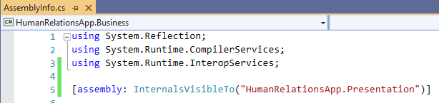
Wiring – expose internals
Add InternalsVisibleTo attribute to the logic and infrastructure layer
In Properties/AssemblyInfo.cs
Presentation layer has now access to the internal classes

Slide 22
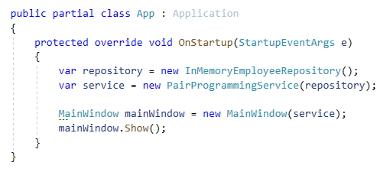
Wiring – Application startup
Override OnStartUp method in App.xaml.cs
Create concrete instances of services and repositories
Inject instance(s) in the Window

Slide 23
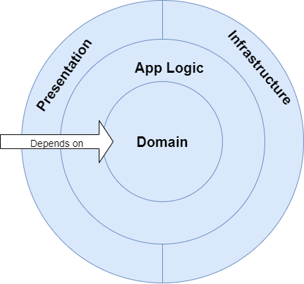
Depencencies
Outer layer can have a dependency on an inner layer
Inner layer does not know outer layers
Notes:
Domain layer does not depend on other layers
Application logic layer depends on domain layer
Infrastructure layer depends on application logic and domain layer
Presentation layer depends on application logic and domain layer
Presentation layer and infrastructure layer don’t know each other.
The classic 3-tier architecture:
Some (classic) architectures use the infrastructure layer as the central layer (usually named “data layer”).
Here the logic layer (usually named “business layer”) sits on top of the data layer and the presentation layer on top of the business layer.
Hence the name “3-tier architecture”.
In this classic architecture there is no domain layer (or the domain layer and data layer are the same).
This architecture builds on the idea that the database of an application is designed first and is the central building block of an application.
Today more and more architects believe that the (business) domain should be the central building block of an application.
The way things are persisted becomes an implementation detail. The database model can be derived from the domain model.

Slide 24
Domain or application logic?
Where should I add some piece of logic?
Whenever possible => domain layer
Domain layer is the central core
Reduces code duplication because logic in the domain layer can be used by multiple components in other layers
Captures core concepts of the business domain
Dependency on other components (e.g. a repository) => application logic layer
Captures application use cases

Slide 25
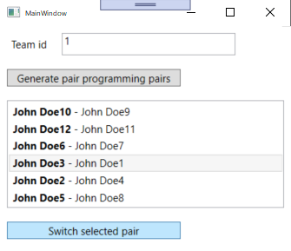
Demo - Add new feature
HR employee wants to be able to switch driver and navigator of a generated pair
Add switch button in presentation layer
Add switch behavior to domain layer
No need to change anything in logic or infrastructure layer

Slide 26
What if?
In what layer would you have to make changes?
Store employees in a csv file
Make sure junior developers (< 5 years experience) are always paired with a senior developer
Select a team from a dropdown list instead of entering the id
Show a steering wheel icon next to the driver (instead of making the name bold)
Notes:
Store emplees in a csv file:
Only the infrastructure layer needs to be changed. We need to add a new (other) implementation of the IEmployeeRepository.
Also the wiring code needs to be changed to instantiate the new repository implementation.
Make sure junior developers (< 5 years experience) are always paired with a senior developer:
A small change in de domain layer is needed (e.g. a StartDate property and a PriorExperience property).
In the application logic layer the pair-picking algorithm should be changed.
The infrastructure layer will probably also need to change (to make sure the new employee properties are also retrieved).
No need to change anything in the presentation layer.
Select a team from a dropdown list instead of entering the id:
No domain layer changes needed.
An ITeamRepository will have to be added in the application logic layer (with a GetAll method)
The ITeamRepository will need a concrete implementation in the infrastructure layer.
In the presentation layer the ITeamRepository is passed in the constructor and used to populate the items of a dropdownlist.
Show a steering wheel icon next to the driver:
Only a small change in the presentation layer is needed.

